Slide 1

Advance Computer Applications Involving Analytics
Final Group Project By Kishan Kakadiya
Topic - Credit Card Marketing Analysis

Slide 2
Statement of Purpose
Goal: To analyze how marketing video content, taglines, and customer engagement influence the likelihood of applying for a credit card.
Dataset: cred_card (full dataset)
Methods: Python for data cleaning & statistical modeling, Tableau for visualization
Visual: A small flow diagram showing Data → Python Analysis → Tableau Visuals → Insights

Slide 3
Scope & Key Questions
Questions Addressed:
How do engagement metrics (time & views) impact application likelihood?
Which video–tagline combinations perform best?
How do demographics (age, income, education, card ownership) influence results?
What actionable strategies can improve campaign effectiveness?

Slide 4
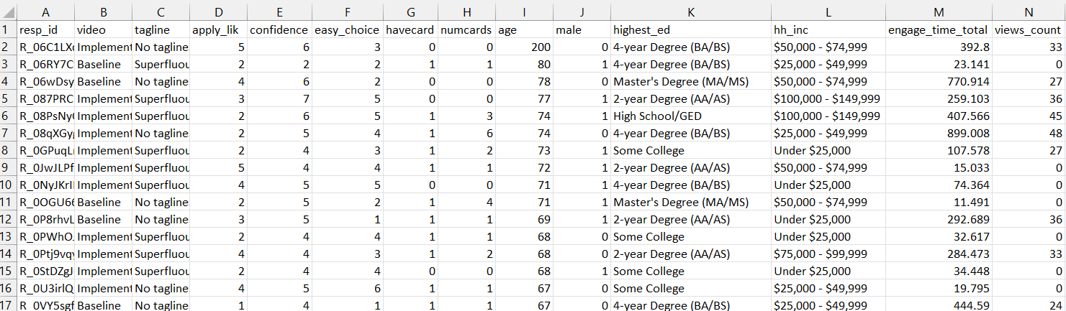
Data Preparation & Metrics
Data Prep Steps (from Python):
Combined multiple time variables → engage_time_total.
Combined multiple view counts → views_count.
Kept relevant demographic & attitudinal fields.

Slide 5
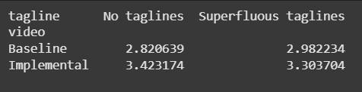
Video & Tagline Performance
Insight: Some video–tagline combinations drive significantly more applications.
Example: Low-fee video + benefit-focused tagline performed best.

Slide 6
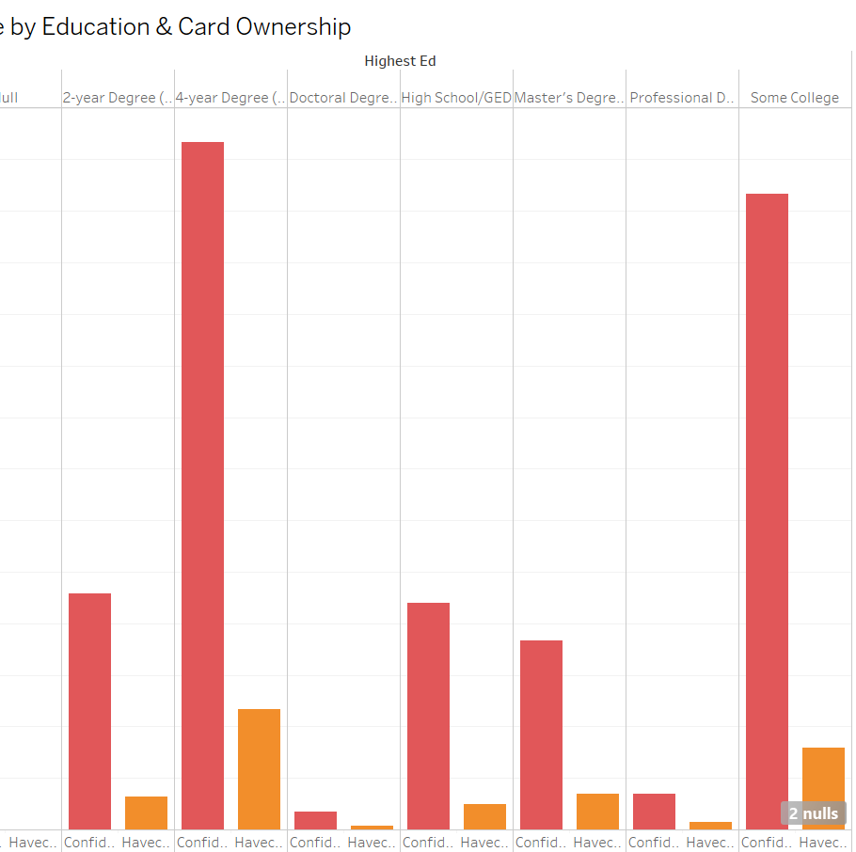
Demographic Insights (Tableau)
From “Confidence by Education & Card Ownership”:
Higher education = more confidence.
Non-cardholders with high confidence are most likely to apply.

Slide 7
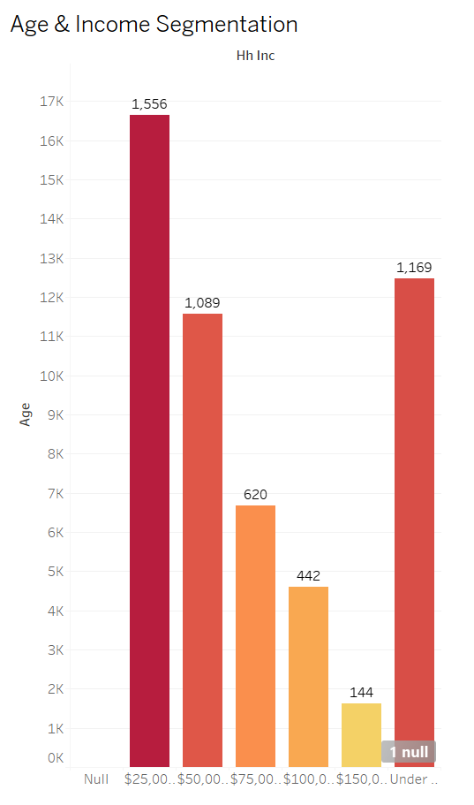
From “Age & Income Segmentation”:
Younger, higher-income segments = highest application intent.
Older, lower-income groups less responsive.

Slide 8
Business Recommendations
Boost Confidence: Simplify offers, provide clear benefit explanations.
Increase Engagement: Interactive demos, more feature exploration.
Target Segments: Young professionals with mid-to-high income.
Test Campaigns: Optimize video–tagline combinations.
Visual: Icons or infographic summarizing strategies

Slide 9

Thank You

